Slide 1


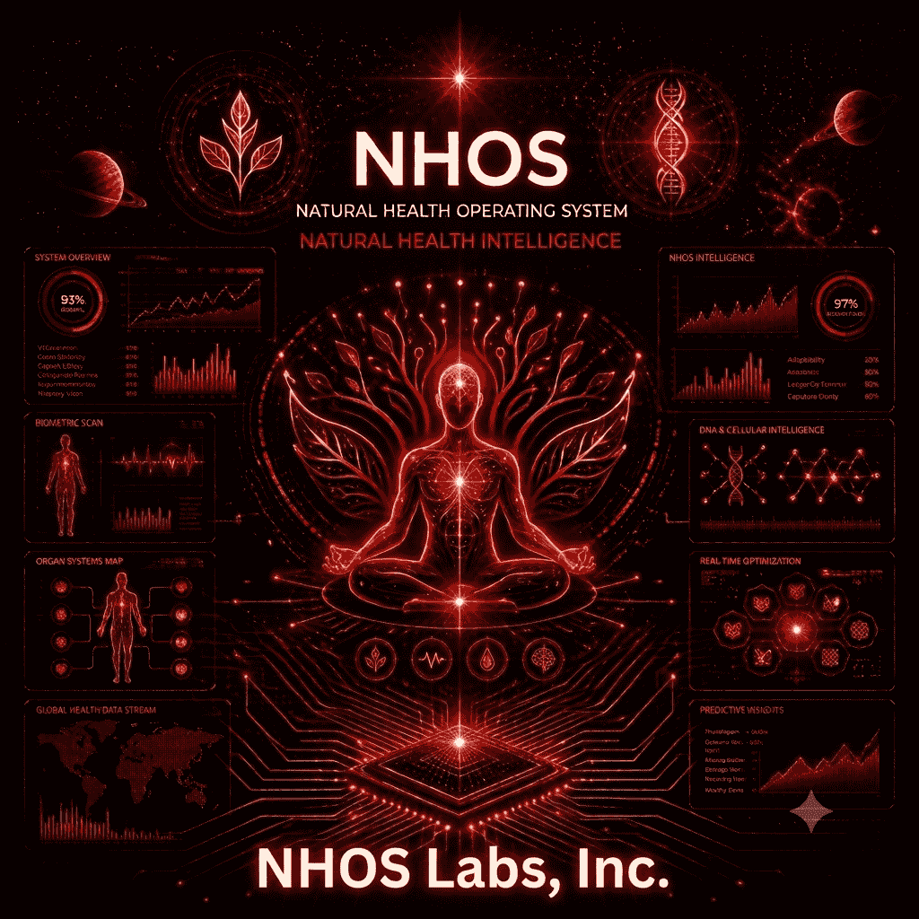
NHOS Labs, Inc.
Building the Future of
Local-First Personal
Health Intelligence
A privacy-first health intelligence ecosystem connecting knowledge, intelligence, research, and personal health.
Stage: Early-Stage Health-Tech Company
Status: Product & Research Foundation Established
Differentiation: Local-first architecture, structured health intelligence, evidence-oriented research
nhos.health | founder@nhos.health | +1 (347) 779-4718

Slide 2

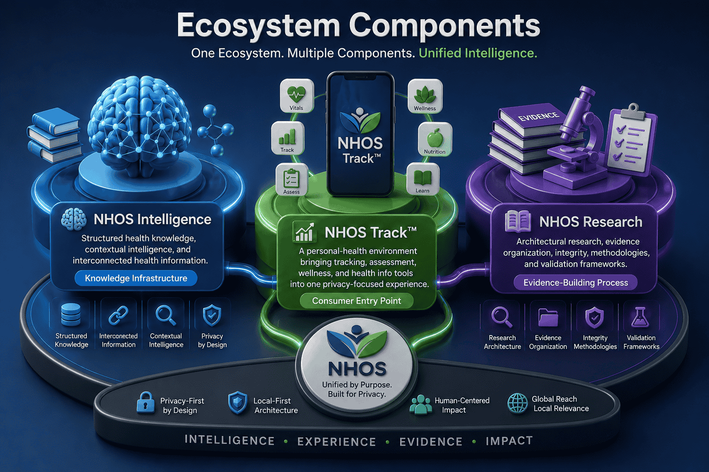
Ecosystem Components
🧠 NHOS Intelligence
Structured health knowledge, contextual intelligence, and interconnected health information.
Knowledge Infrastructure
📊 NHOS Track™
A personal-health environment bringing tracking, assessment, wellness, and health info tools into one privacy-focused experience.
Consumer Entry Point
📚 NHOS Research
Architectural research, evidence organization, integrity methodologies, and validation frameworks.
Evidence-Building Process
One ecosystem. Multiple entry points. Continuous context.

Slide 3




Personal Health Is Fragmented
People increasingly manage their health through disconnected applications, information sources, trackers, calculators, assessments, and records.
Fragmented Information
Disconnected Experiences
Limited Continuity
Health information is distributed across multiple tools and platforms without synthesis.
Users repeatedly enter, interpret, and organize similar information across silos.
Context can be lost when moving between different digital and physical applications.
🔸 Growing Privacy Concerns — Personal health information increasingly passes through systems users do not control.
🔸 Cloud Dependency — Many digital experiences assume persistent connectivity and centralized infrastructure.
The Opportunity: Not simply to build another health app, but to create a more interconnected, privacy-oriented model for personal health intelligence.

Slide 4


Why Now? A New Phase in Health Tech
🤖 AI Expectations
🔒 Privacy Value
People increasingly expect health technology to provide contextual, personalized, and intelligent experiences.
Users and institutions increasingly value transparency, control, and minimization of unnecessary data movement.
📱 Digital Shift
💻 Local Computing
Tracking, wellness, medications, symptoms, and health information are rapidly moving into consumer software.
On-device and local-first architectures reduce routine dependence on centralized services.
The next generation of personal health technology must be not only intelligent, but private, interconnected, and user-controlled.

Slide 5



Market Opportunity
TAM — Global Digital Health
SAM — Global mHealth Apps
Adjacent — PHR Software
$650B+ by 2032
~$45B in 2026
~$53B in 2026
Digital health technologies, services, monitoring, mHealth, health IT, and related solutions.
Mobile health applications supporting monitoring, wellness, fitness, disease management, health education.
Personal health record and health-information organization software.
Source: 6WResearch; projected global market >$653.8B by 2032.
Source: Fortune Business Insights; 2026 estimate $45.14B.
Source: Fortune Business Insights; estimates vary by provider.
NHOS focus: A privacy-oriented, local-first segment within the broader mHealth market.
SOM — NHOS Initial Addressable Opportunity: Bottom-up model in development.

Slide 6


NHOS's Architectural Focus
NHOS Design Focus
Local-first experience — Prioritizes local processing and user-controlled information
Offline-capable workflows — Defined functions can operate without persistent connectivity
Core Integration
NHOS combines local-first personal-health architecture, a dedicated health intelligence layer, specialized interconnected functions, and an evidence-oriented research program into one ecosystem.
Integrated health context — Connects tracking, knowledge, assessment, and health-information workflows
Evidence-oriented knowledge — Organizes references, context, and health-information relationships
Research-informed development — Uses documentation and validation frameworks to guide further evaluation

Slide 7



Our Vision
"A world where personal health intelligence is private, interconnected, and under the user's control."
NHOS Labs, Inc. is building toward this vision through a local-first health intelligence ecosystem connecting:
🧠 NHOS Intelligence
📚 NHOS Research
📊 NHOS Track™
Structured health knowledge, contextual intelligence, and interconnected health information.
Architectural research, evidence organization, integrity methodologies, and validation frameworks.
A personal-health environment bringing tracking, assessment, wellness, and health info tools into one privacy-focused experience.
One ecosystem. Multiple entry points. Continuous context.

Slide 8

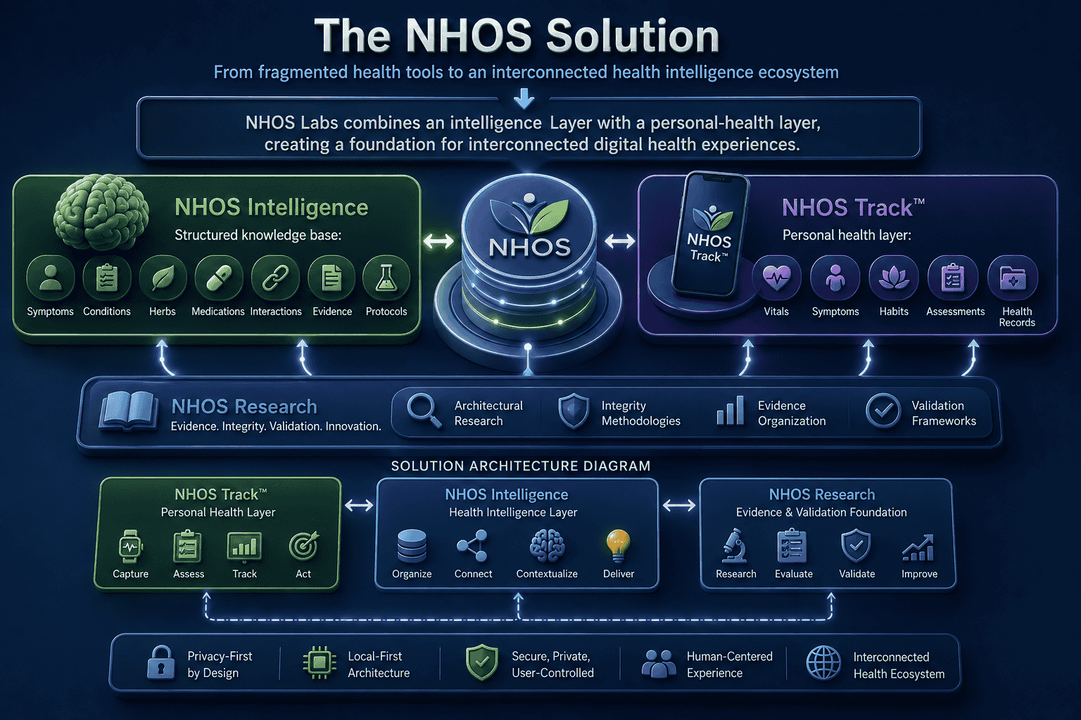


The NHOS Solution
From fragmented health tools to an interconnected health intelligence ecosystem
NHOS Labs combines an intelligence layer with a personal-health layer, creating a foundation for interconnected digital health experiences.
🧠 NHOS Intelligence
Structured knowledge base:
Symptoms • Conditions • Herbs • Medications • Interactions • Evidence • Protocols
📊 NHOS Track™
Personal health layer:
Vitals • Symptoms • Habits • Wellness • Assessments • Health Records

Slide 9

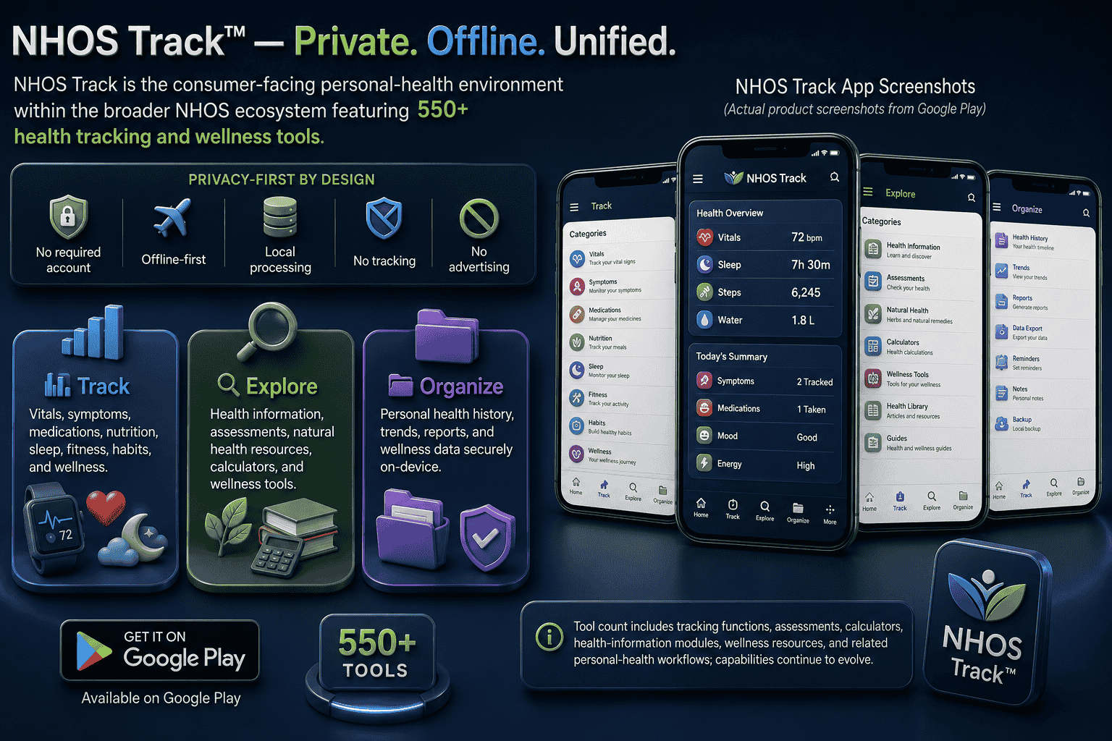

NHOS Track™ — Private. Offline. Unified.
NHOS Track is the consumer-facing personal-health environment within the broader NHOS ecosystem featuring 550+ health tracking and wellness tools.
Privacy-First by Design:
No required account • Offline-first • Local processing • No tracking • No advertising
Track: Vitals, symptoms, medications, nutrition, sleep, fitness, habits, and wellness.
Explore: Health information, assessments, natural health resources, calculators, and wellness tools.
Organize: Personal health history, trends, reports, and wellness data securely on-device.
⬇️ Available on Google Play | Tool counts and capabilities continue to evolve.
Disclaimer: NHOS supports personal health organization, educational exploration, and wellness workflows. It does not provide diagnosis, emergency guidance, or professional medical care.

Slide 10





NHOS Intelligence
The intelligence layer is designed to make health information more structured, connected, contextual, and usable across the NHOS ecosystem.
📚 560+ Health Conditions
🌿 1,450+ Herbal Profiles
Structured condition and health-topic knowledge supporting the NHOS intelligence layer.
Structured herbal/remedy profiles integrated into the NHOS knowledge infrastructure.
🔗 13,000+ Symptom Mappings
📖 1,500+ Academic References
Structured relationships connecting symptoms with relevant health conditions and knowledge pathways.
Academic and peer-reviewed sources supporting the broader NHOS evidence infrastructure.
🧠 NIME™ — NHOS Intelligence Matrix Engine™, the architectural framework for organizing, connecting, and processing health intelligence.
🛡️ Health-Tech Copywriting Integrity Checker™ — Technology designed around local intelligence and evidence-oriented validation.
Counts reflect the NHOS knowledge base as of March 2026. NHOS does not provide diagnosis, emergency guidance, or professional medical care.

Slide 11

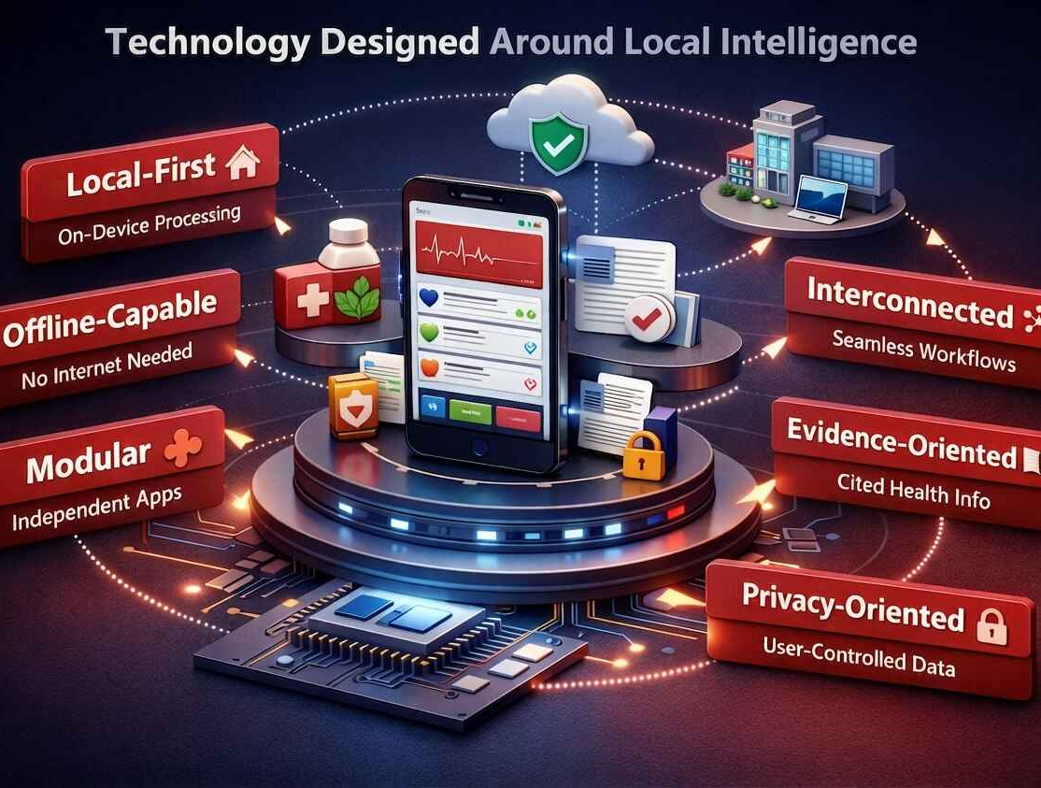
Technology Designed Around Local Intelligence
NHOS is designed as an ecosystem architecture—not simply as a collection of independent applications.
Local-First: Core experiences prioritize local execution and user-controlled info.
Offline-Capable: Defined workflows can operate without continuous network connectivity.
Interconnected: Applications participate in shared workflows and contextual transitions.
Evidence-Oriented: Health info organized with references, guidelines, and contextual evidence.
Modular: Specialized apps operate independently while participating in the ecosystem.
Privacy-Oriented: Minimization of unnecessary external data transmission.
NHOS supports personal health organization and wellness workflows. It does not provide diagnosis or professional medical care.

Slide 12




Privacy Is an Architectural Principle
NHOS Labs designs around the principle that personal health information should remain under meaningful user control.
Important: Privacy-oriented architecture is a design objective—not a substitute for empirical security validation.
🔒 Local Processing
📴 Offline Capability
🚫 No Routine Tracking
Process info locally where functionally appropriate.
Reduce dependence on continuous connectivity.
Designed without routine behavioral tracking.
👤 User Control
📦 Data Minimization
🛡 Security by Design
Personal data built around user-controlled local storage.
Minimize unnecessary transmission and external exposure.
Incorporated directly into core architectural decisions.
NHOS supports personal health organization and wellness workflows. It does not provide diagnosis or professional medical care.

Slide 13

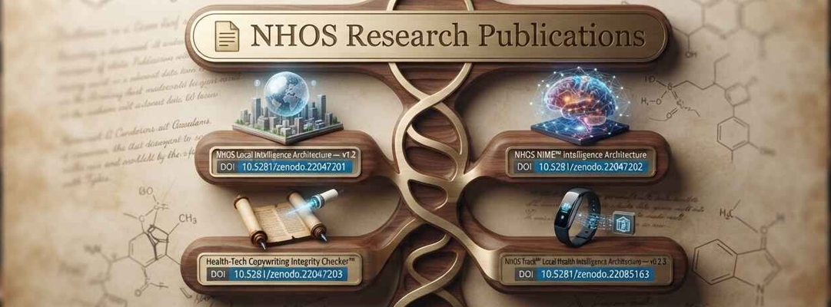





From Architecture to Evidence
NHOS Labs treats research as an evidence-building process rather than a substitute for evidence.
🔬 Research Areas: Local Intelligence Architecture • NIME™ Architecture • NHOS Track Intelligence • Health-Tech Copywriting Integrity Checker™
📋 Evidence Discipline: Implemented → Measured | Preliminary Evidence → Validation Planned | Future Research — ongoing
📄 Featured Publications (DOI-indexed):

Slide 14

NHOS Development Foundation
Product, intelligence, research, and corporate milestones established.
📱 NHOS Track™
🧠 Intelligence
📚 Research
🏢 Corporate
•
Production app
•
Structured knowledge
•
Research Program
•
NHOS Labs identity
•
Hundreds of functions
•
Oracle Hybrid Search
•
DOI-indexed papers
•
D-U-N-S registration
•
Google Play distribution
•
NIME™ architecture
•
Validation frameworks
•
Commercialization path
•
Consumer landing page
•
Local Intelligence
•
Integrity Checker
•
Partnership outreach
The initial technology, product environment, research program, and corporate structure are in place. The next phase is user learning, independent evaluation, strategic collaboration, and responsible ecosystem development.

Slide 15

Collaboration Pathways
NHOS is designed to support different forms of aligned participation.
🔬 Research
💻 Technology
📣 Distribution
🤝 Strategic
Independent evaluation, publications, validation frameworks, and institutional inquiry.
Privacy, security, architecture, integration, and co-development exploration.
Community access, wellness education, consumer reach, and mission-aligned partnerships.
Long-term ecosystem guidance, advisory relationships, and exploratory investment dialogue.

Slide 16


A Growing Ecosystem, Built Responsibly
NHOS Track provides a practical personal-health entry point. NHOS Intelligence and NHOS Research create foundations for deeper collaboration, validation, and future capability development.
👤 User-centered personal-health tools
📚 Independent research & evaluation
Tracking, organization, and exploration designed for privacy and continuity.
Evidence-building process with documented validation frameworks.
🧠 Structured & contextual health knowledge
🤝 Responsible tech & institutional collaboration
Intelligence layer connecting symptoms, conditions, remedies, and evidence.
Partnerships built on shared values of privacy, integrity, and user control.

Slide 17
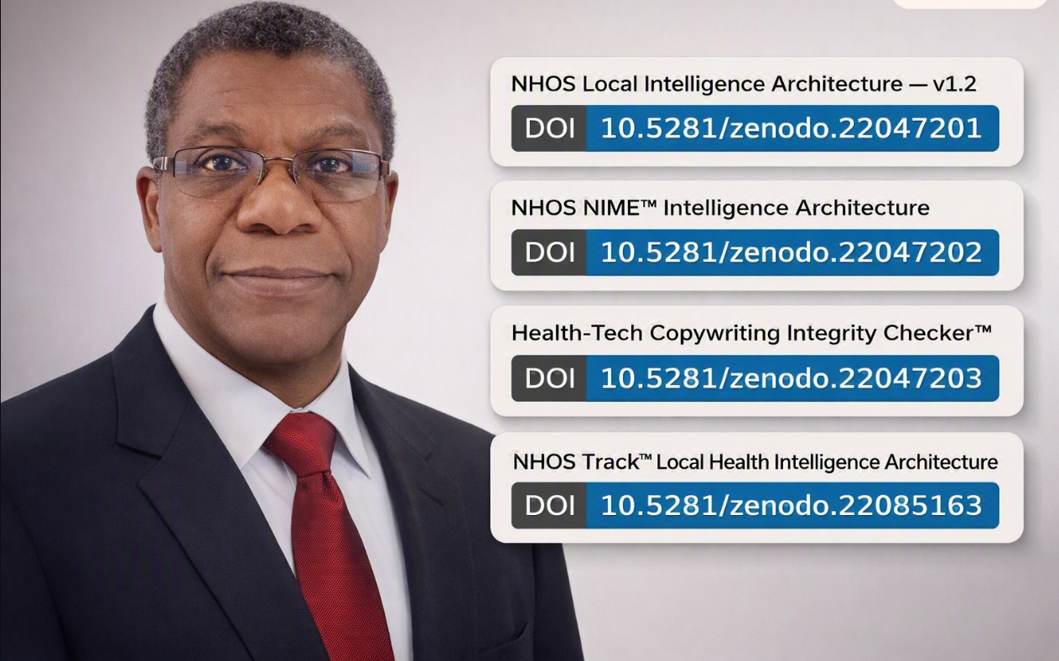
Founder & Roadmap
Adedapo Ogundiran — Founder & CEO, NHOS Labs, Inc.
Healthcare Management • Clinical Informatics • Healthcare Analytics • Systems Architecture • Digital Health
Founder-led development of a local-first personal health intelligence ecosystem, spanning health intelligence architecture, knowledge systems, privacy-oriented computing, personal-health applications, and evidence-driven research.
✅ Member, American Medical Informatics Association (AMIA)
🪪 ORCID iD: 0009-0003-8025-1116
📌 Roadmap:
• NOW — Product Refinement & Engagement: Product refinement, user learning, early community engagement, strategic outreach
• NEXT — Independent Validation: Independent validation, research collaboration, architecture evaluation, reproducible testing
• NEXT — Strategic Collaboration: Distribution, technology, research, and institutional collaboration
• LONGER TERM — Ecosystem Growth: Expanded health-intelligence capabilities, carefully governed deployments, strategic growth

Slide 18


Strategic Development Priorities
NHOS is entering a phase of focused refinement, independent evaluation, and collaboration.
📱 Product and Experience
📚 Research and Validation
Refine NHOS Track, reliability, accessibility, and user workflows.
Expand reproducible testing, technical documentation, and institutional collaboration.
🔒 Privacy and Security
🤝 Partnership Development
Strengthen architecture review, data-governance documentation, and independent assessment.
Explore distribution, technology, research, community, and strategic ecosystem relationships.

Slide 19

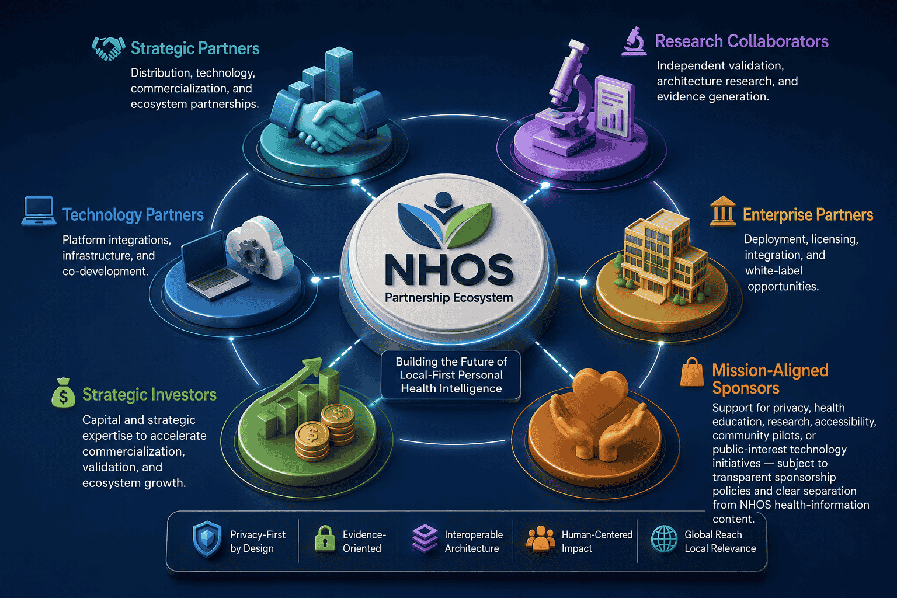
Let's Build the Future of Personal Health Intelligence
Strategic Partners: Distribution, technology, commercialization, and ecosystem partnerships.
Research Collaborators: Independent validation, architecture research, and evidence generation.
Enterprise Partners: Deployment, licensing, integration, and white-label opportunities.
Technology Partners: Platform integrations, infrastructure, and co-development.
Strategic Investors: Capital and strategic expertise to accelerate commercialization and growth.
Mission-Aligned Sponsors: Support for privacy, health education, research, accessibility, and community pilots.

Slide 20
NHOS Labs, Inc.
Building the Future of Local-First Personal Health Intelligence
🔗 NHOS: nhos.health | 📄 Research Registry: nhos.health/research
📱 NHOS Track: nhos.health/track | ℹ️ About: nhos.health/about/
Adedapo Ogundiran, Founder & CEO
📧 founder@nhos.health | 📞 +1 (347) 779-4718

